Slide 1
Predicting Movie Genres from Plot Summaries
An Analysis of Film Data
Data Analysis Findings
October 17, 2025
Genre Prediction

Slide 2




Agenda
1
Exploratory Data Analysis (EDA)
2
Modeling
3
Feature: Spoiler-Free Summarization
4
Conclusion
Genre Prediction

Slide 3
EDA: Key Findings Overview
I started by analyzing the dataset to understand its underlying patterns and characteristics.
This exploration guided the data cleaning, preprocessing, and modeling strategies.
Key areas of interest included the origin of films, release trends, genre distribution, and recurring elements like titles and cast.
Genre Prediction

Slide 4
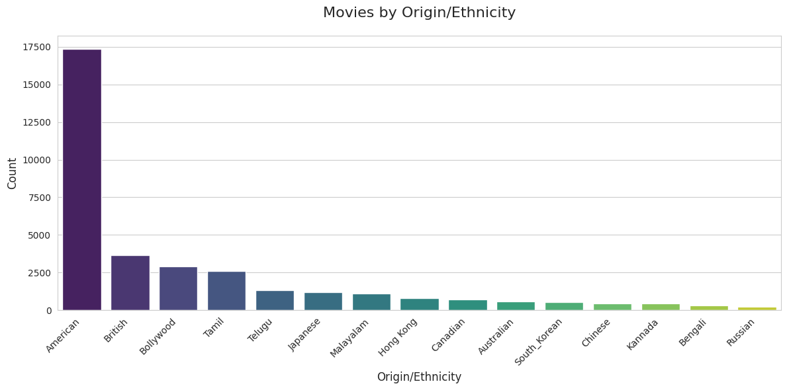
Ethnecity / Origin: A US-Dominated Landscape
American movies overwhelmingly dominate the dataset.
Followed by productions from Great Britain and India.
This reflects the global footprint of Hollywood and the English-language film industry.
Genre Prediction
4 / 12

Slide 5
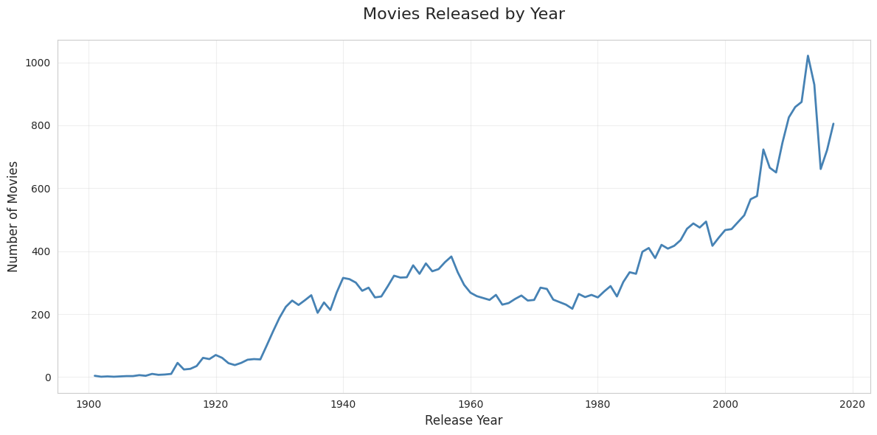
Historical Trends in Movie Production
Exponential Growth: A significant surge in movie production began in the 1970s.
Cold War Slowdown: A noticeable dip in production occurred during the Cold War period.
Post-WWI Boom: Production increased heavily after the First World War, likely due to technological advances and the US’s relative distance from the conflict.
Genre Prediction

Slide 6
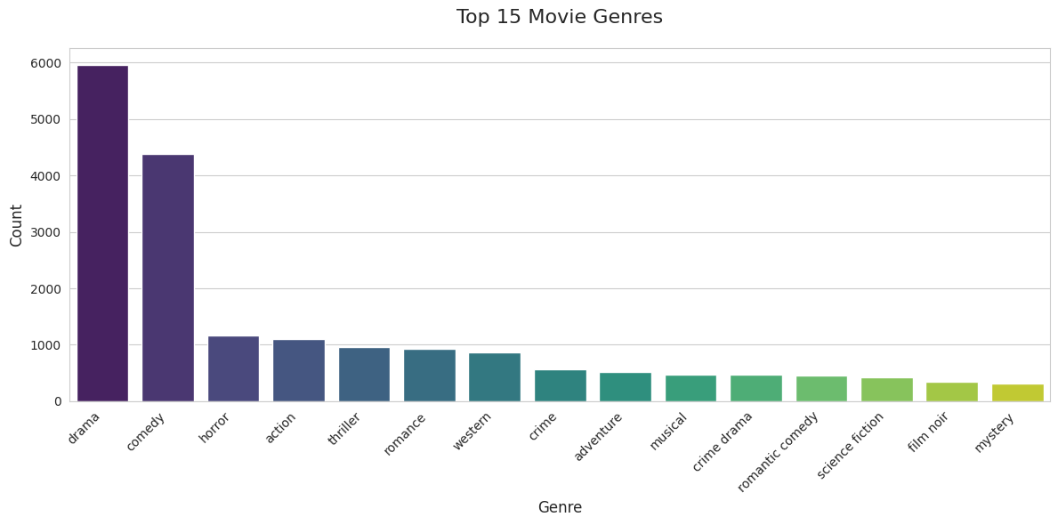
Drama and Comedy Reign Supreme
The distribution of genres is highly skewed.
Drama and Comedy are the most frequent genres, suggesting broad, cross-cultural appeal.
Many genres appeared only once. To ensure meaningful analysis, we decided to focus on the top 25 most common genres.
Genre Prediction

Slide 7
Recurring Titles, Cast, and Directors
Movie Titles: Sequels and remakes are common. Cinderella was the most remade film. Common titles like ”Love” also appeared multiple times.
Cast Members: Sequels, especially in animation, led to high mention counts for characters. Tom and Jerry appeared in over 80 films.
Directors: The same directors often worked on multiple films within a series or for a specific studio. The top 10 directors in the dataset directed 50+ films each.
Genre Prediction

Slide 8
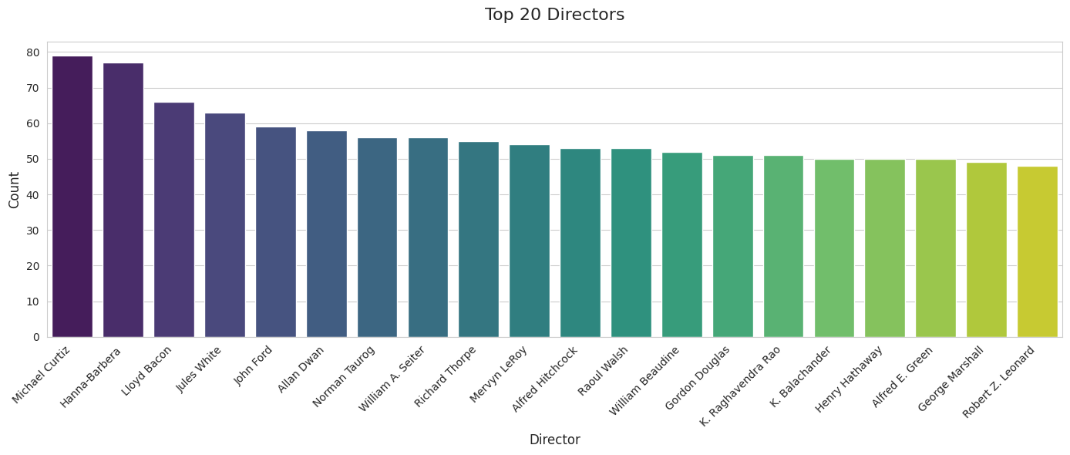
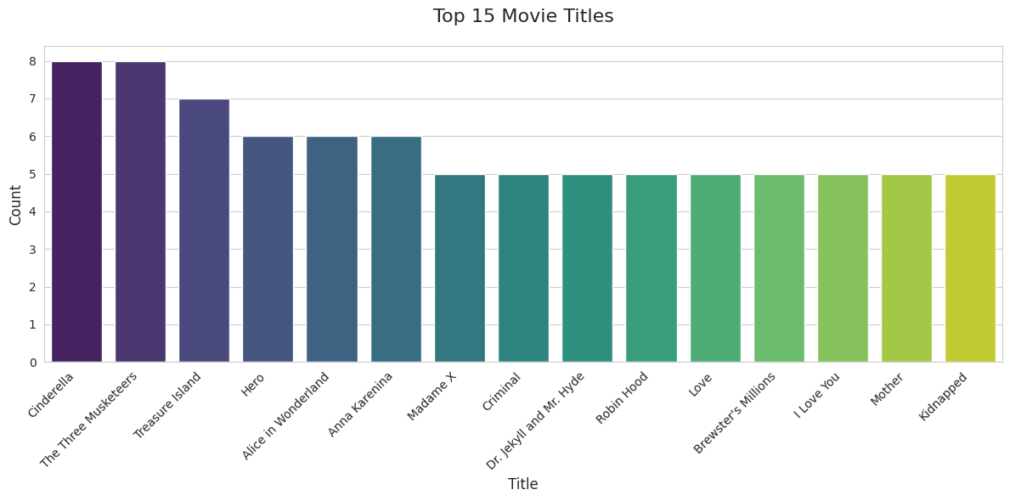
Recurring distribution in Titles, and Directors

Slide 9
From Raw Data to Model-Ready Input
Data Cleaning: The first step was to remove duplicates, missing values, and records with ”Unknown” genres to create a clean dataset.
Preprocessing - Two Approaches Tested:
Approach A (Direct): Used a BERT tokenizer to convert the full movie plots directly into tokens.
Approach B (Summarize First): Used a Qwen2.5 model to summarize the plots before tokenization to reduce the token count.
Genre Prediction
8 / 12

Slide 10
Searching for the Best-Performing Model
We tested three different classification methods:
Simple Machine Learning: A baseline model trained on the tokenized plot.
Pretrained TinyBERT (Full Plot): A classifier trained using the full, tokenized plots.
Pretrained TinyBERT (Summarized Plot): A classifier trained on the tokens from the summarized plots.
Result: All three models achieved a similar accuracy of around 40% on the 25-genre classification task.
Genre Prediction

Slide 11
A Practical Application: Spoiler-Free Summaries
We leveraged a local language model to create a value-added feature.
Technology: Ran the Qwen2.5 (3B) model locally using OLLAMA.
Method: By engineering a specific prompt, we could instruct the model to generate concise plot summaries while strictly avoiding any spoilers.
This shows a powerful, practical use-case for LLMs in media applications.
Genre Prediction

Slide 12
Conclusion & Key Takeaways
EDA Insights: The movie dataset is heavily dominated by US-made Drama and Comedy films, with production booming since the 1970s.
Modeling Challenge: Predicting one of 25 genres from plot alone is a complex task, with our models achieving around 40% accuracy.
Summarizing plots first did not significantly impact performance, although it increased the epochs speed dramatically.
LLM Potential: Modern LLMs show great promise for related tasks, such as generating high-quality, spoiler-free summaries for viewers.
Genre Prediction

Slide 13
Thank you.
Genre Prediction

